Slide 1
Radiant Squish Introduction
June, 2024

Slide 2
Content
1. Squish brief introduction
2. Main function introduction
Record preparation
Record case
3. Public function
4. Common Issue

Slide 3
1 Squish brief introduction
Choose correct squish
squish-7.2.1-qt65x-win64-msvc142
Choose language
Perl
Squish address
\\lsh-smb04\sw\qa\qa_store\TMP_tools\depend_software\squish-7.2.1-qt65x-win64-msvc142.exe
Squish --Qtversion--OS—compiler
Python
Javascript
TCL
squish-7.2.1-qt65x-linux64

Slide 4
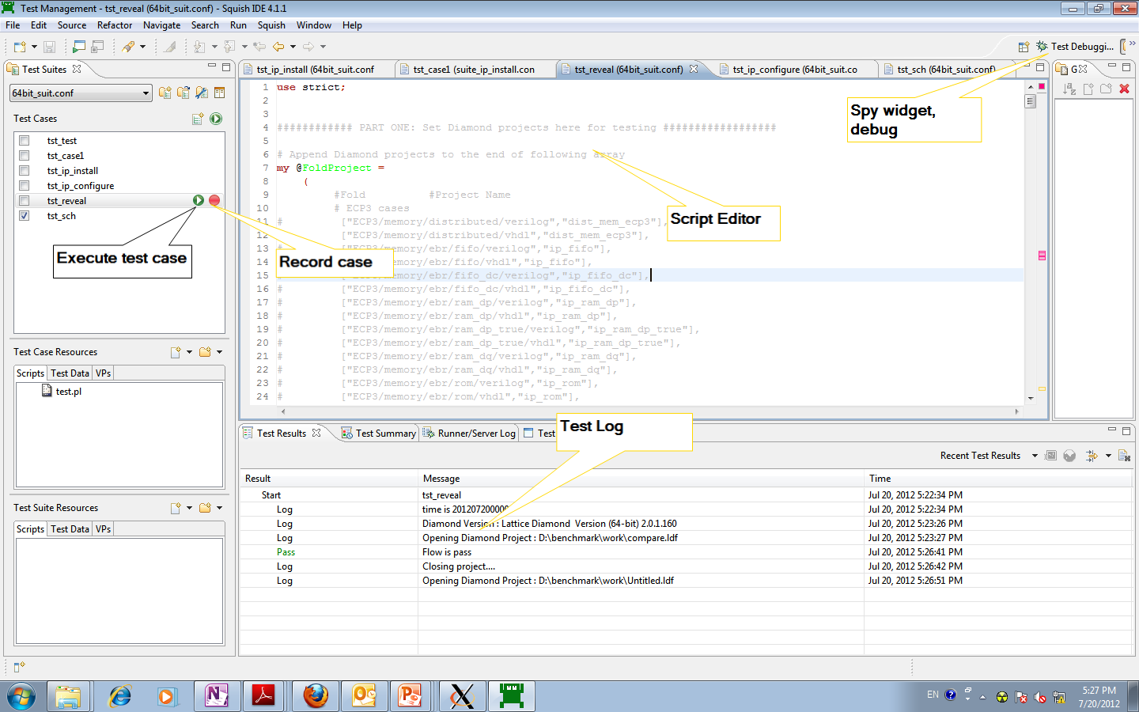
1 Squish brief introduction

Slide 5
Main function introduction
Record preparation
Download radiant GUI template from Client demo folder
<Client install path>/doc/TMP_example/standard_suite2/gui_flow
New test suite and case
Suite name standard
Suite structure standard
Note: Please install Client first

Slide 6
Suite Name standard
silicon_01_softip
silicon_02_thunderplus
pn_20_project_navigator
pn_21_strategy_manager
pn_22_file_list
pn_23_process_view
pn_24_hierarchy_view
pn_00_tcl_console
pn_25_output_view
pn_26_start_update
pn_27_help_integration
pn_28_report_view
pn_29_message_system
pn_2a_device_cover
flow_00_design_entry
flow_01_command_line
constraint_00_tcf
constraint_01_pcf
constraint_20_tce
constraint_20_dce
impl_00_synthesis_engine
impl_01_mapar_engine
impl_02_bit_generate
qor_00_general
analysis_00_ta_engine
analysis_20_power_calculator
analysis_21_ta_view
analysis_01_simulation
debug_10_reveal_inserter
debug_20_reveal_analyzer
debug_21_direct_programmer
debug_11_deployment_tool
debug_12_embedded_programmer
gui_20_floorplan_view
gui_21_physical_view
gui_22_epic
gui_23_netlist_analyzer
gui_24_simulation_wizard
gui_25_source_editor
misc_20_os_cover

Slide 7
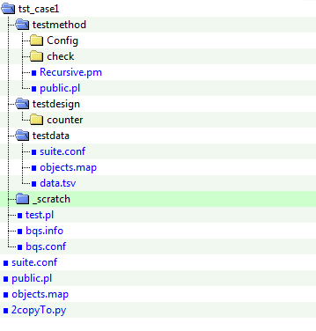
Suite structure standard
test.pl
bqs.info
bqs.conf
public.pl
objects.map
copyTo.py

Slide 8
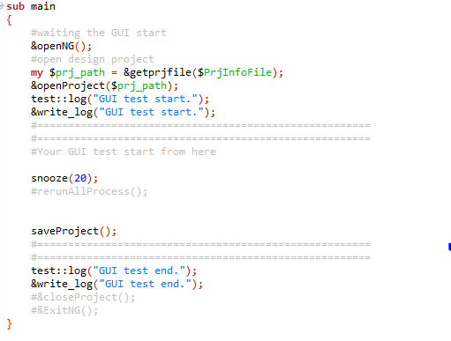
Suite structure standard
Open radiant
Open project
your script
Close project
Close radiant

Slide 9
Prepare Radiant layout
Default Layout
--Maximize Radiant window
--Open 6 views(only Find Results view close)
--Close Radiant
Customized Layout
--Set suitable size and location
--Close Radiant
--Copy Radiant layout file pnmain_setting.ini
from C:\Users\[name]\AppData\Roaming\LatticeSemi\DiamondNG\
to test suite.
Layout keep consistent with default layout when close Radiant

Slide 10
Record flow
Start
Add Snooze(20); or Breakpoint
Pause when execute case
Record snippet
Do operation
Stop recording
Resume or Terminate
End
Notes:
Reveal inserter

Slide 11
Tips
Remove Snooze(20); or Breakpoint.
Add snooze() function to provide possible playback reliability.
Recommend not recording more than 20 test items in one script.
Add test::log/pass/fail(""); for test result show clearly.
Add sequence number before each PASS or FAIL. eg, test::pass("4-1-PN-Lattice Radiant Help pass");

Slide 12
3 Public function
Common functions in public.pl:
openNG();
ExitNG();
openProject();
saveProject();
closeProject();
pathTransType();
rerunAllProcess ();
runsynProcess ();
runmapProcess();
runparProcess();
runexportProcess();

Slide 13
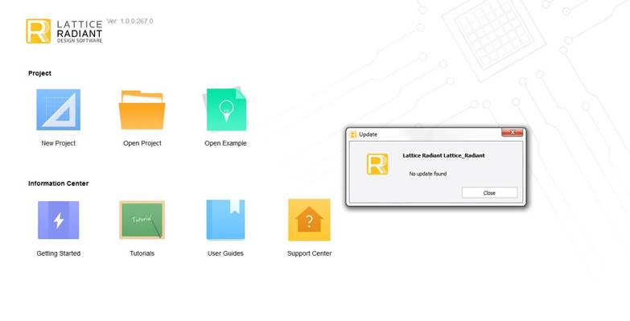
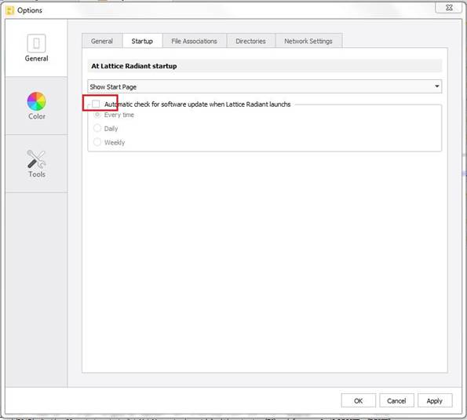
4 Common Issue
4.1 Update Dialog Issue
Reset Radiant option to close “Update” dialog.
Delete scripts on close “Update” dialog in your squish script.
Please use template when you create new suite. It can deal with “Update” dialog issue.

Slide 14
Q&A
Thanks

